Slide 1
Collaborative Technologies
CIS 300: Computer Information Systems
Professor Matt Thatcher

Slide 2
Start Tegrity!

Slide 3
Homework Assignment 1
Turn in Homework Assignment 1
  Assignment 1 does not use MS Excel
    You should evaluate and create formulas without MS Excel
    Enter your responses in the Word template provided
  Due: Mon, Jan 25 by 11:30pm
  Turning in Assignment 1
    BB > Assignments > Submit Work Here > Homework 1
      Comments: put the name of each team member
        Also remember to enter each name in the Assignment 1 document as well
      Attach Local File: upload your completed Assignment 1 in MS Word format
      Click Submit
      Check BB > My Grades to verify it was accepted (look for )

Slide 4
Last Class
Define
  Efficiency, effectiveness, and productivity
  How does IS affect these three performance metrics?
  What does it mean to automate a business activity?
    Think about the 5 components of an IS
Identify and describe the relationship among different organizational IS
  TPS
  FAIS and the support they provide for each functional area of the organization
  ERP systems
  CRM systems
  SCM systems

Slide 5
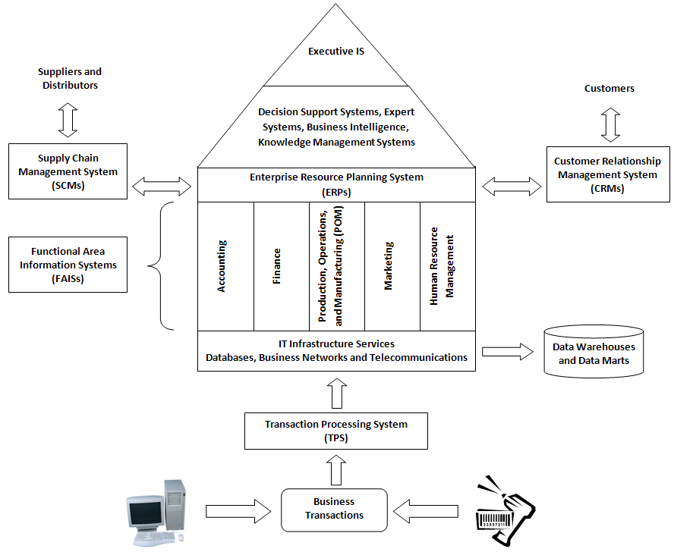

Slide 6
Today’s Agenda
What is collaboration?
How do teams use IS to support
  Written communication?
  Verbal communication?
  Meeting communications?
How do teams use IS to share resources?
  Configuration management
  Workflow management

Slide 7
What Is Collaboration?
Collaboration
  Two or more people
  Working together
  Toward a common goal, result, or product
  Often over great distances
Teams use information systems to facilitate collaboration
  Communication
  Sharing resources

Slide 8
How Do Teams Use IS to Communicate?
IS facilitate various forms of communications
  Written
  Verbal
  Presentation
  Meetings
  Distance Learning

Slide 9
What IS Support Written Communications?
E-mail
  Electronic messaging through the Internet
IM
  Instant messaging through mobile devices
Blogs
  Electronic logs maintained on the Internet (weblogs)
Wikis
  Common knowledge base maintained by users
  Store and publish group’s knowledge
  http://wikipedia.org
Team portals
  Web site that publishes information about team’s activity
  Schedules, tasks information, calendars

Slide 10
Instant Messaging
Instant messaging (IM)
  Real-time chat
  Form of synchronized e-mail
  Chat room
    Communicate with a group
  Free applications for IM include:
    AIM: AOL instant Messenger
    Yahoo Messenger
    MSN Messenger
  Business uses
    Customers can chat with sales or support reps

Slide 11
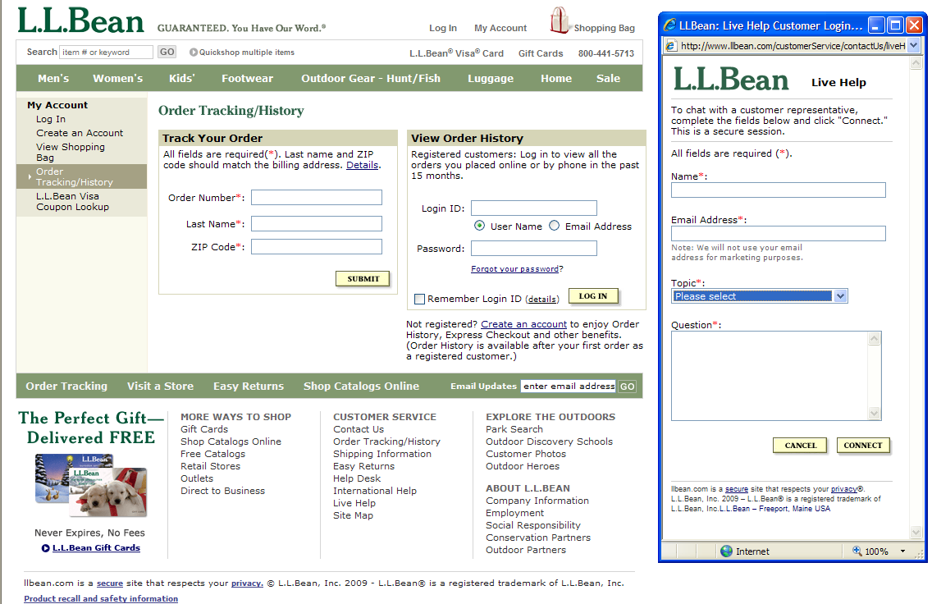

Slide 12
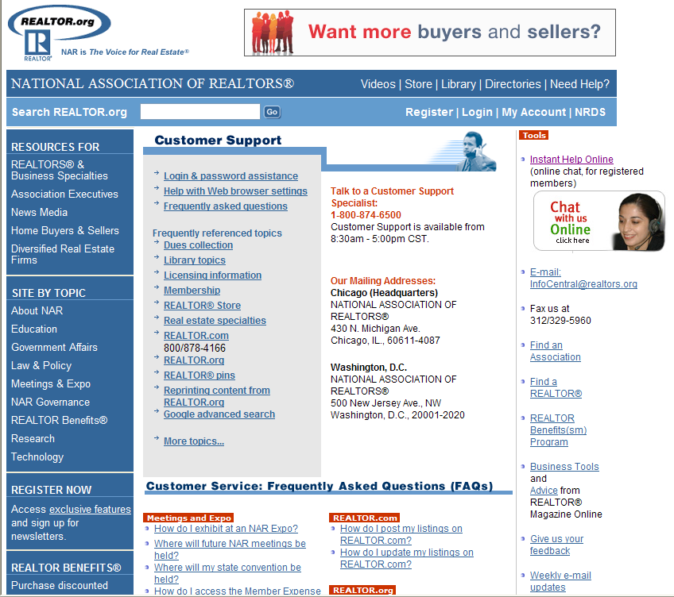

Slide 13
Wikis
Wiki (from Hawaiian, meaning “quick”)
  Web application that enables users to add to and edit the contents of Web pages
  All the software required to edit the Web pages is embedded in the pages themselves
Wikipedia
  a popular online encyclopedia
  http://wikipedia.org
Wiki technology is a popular ingredient in groupware (software used for collaboration)

Slide 14
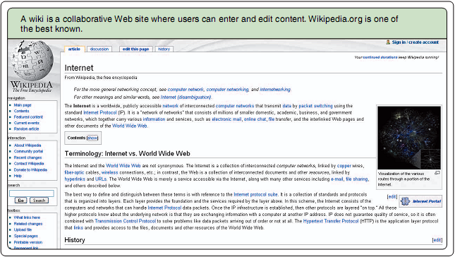
Wikipedia
(Example)

Slide 15
Blogs
Contraction of “Web log”
  Personal website, open to the public, in which the site creator expresses his or her feeling, opinions, information, or whatever the creator wants
  Invites surfers to post opinions and art
  Focuses on a topic or set of topics
  Trackback
    A tool that notifies bloggers when their posts have been mentioned elsewhere on the Web
  Blogosphere
    Term for the millions of blogs on the Web
Types of Blogs
  Corporate blogs
  CEO blogs
    http://boeingblogs.com/randy (Randy Tinseth, VP marketing)
  Industry blogs
  Department/Product blogs
  Customer Service Blogs
  Others (more personal)
    http://www.jaredwsmith.com/blog
      Tracking weather, sports, politics, or whatever comes to his mind

Slide 16
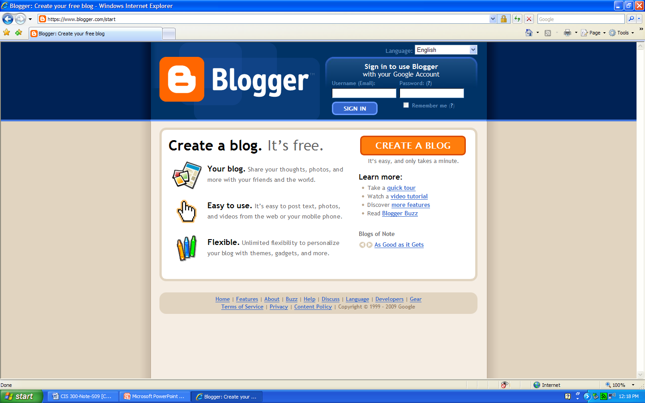
Creating a Blog
(www.blogger.com)

Slide 17
Blogs
(Examples)
Corporate Blogs
  Find out what blog participants think and say about the organization
  Often blogs about products, services, and customers
    http://googleblog.blogspot.com (Google)
    http://blogs.adobe.com (Adobe)
    http://blog.facebook.com (Facebook)
    http://direct2dell.com/one2one (Dell)
Nice article on the Top 15 Corporate Blogs
  http://mariosundar.wordpress.com/2008/05/05/top-15-corporate-blogs-ranked-may-2008

Slide 18
Blogs
(Examples)
Notice the features (or anatomy) of many blogs
  Date (chronological list of journal-like entries)
  Archives (by date, by poster)
  Links to previous posts
  Comments on entries (makes it a two-way conversation)
  Email entries to others
Nice video tutorial
  http://www.jimandchris.com/tutorials/blogging/blog-examples.html
  About 6 minutes long
  Walks you through the narrator’s favorite blogs

Slide 19
What Information Systems Support Verbal Communications?
Cellular Phones
VoIP
  Voice over IP (Internet Protocol)
    Providers include www.vonage.com and www.skype.com
  Communications over the Internet
  Digital
    Can be saved
    Sent as attachments
    Turned into podcasts
Podcasts
  Digital files
  Can be downloaded and played

Slide 20
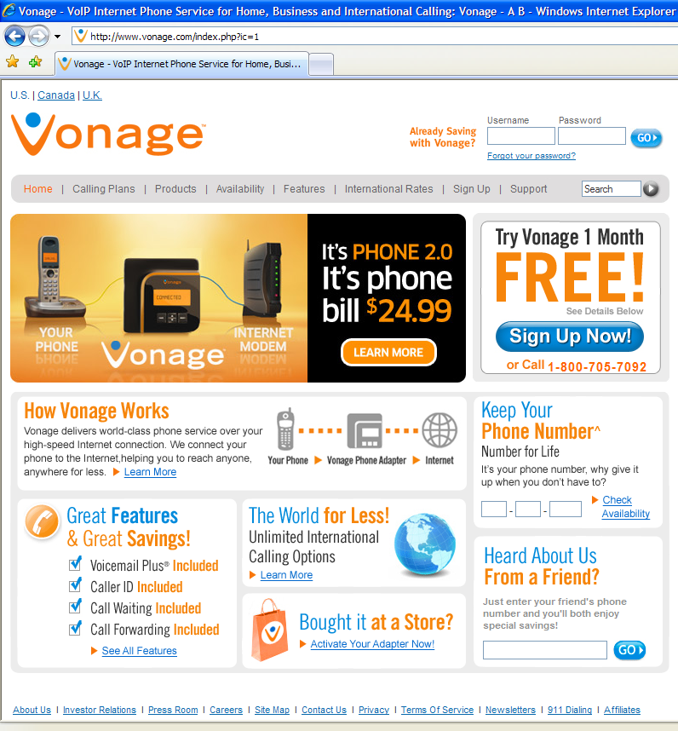
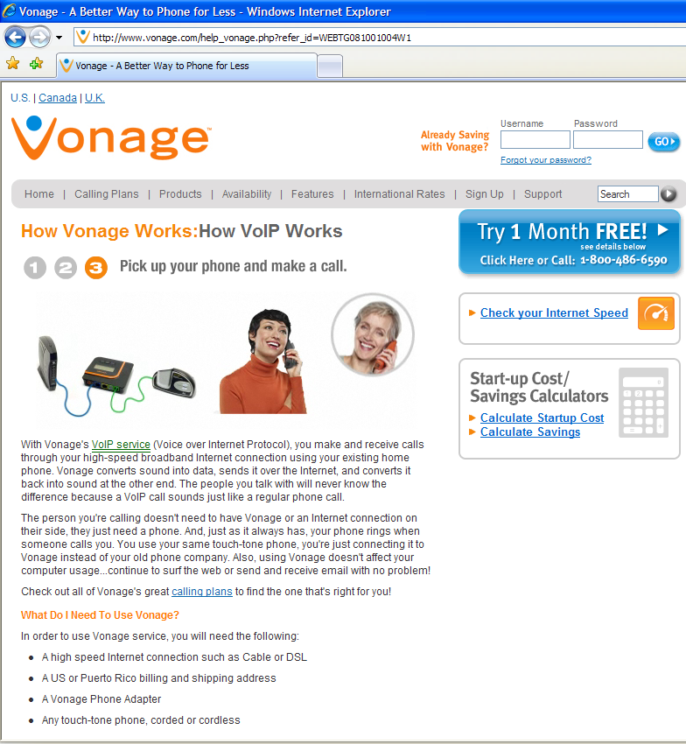
VoIP
(www.vonage.com)

Slide 21
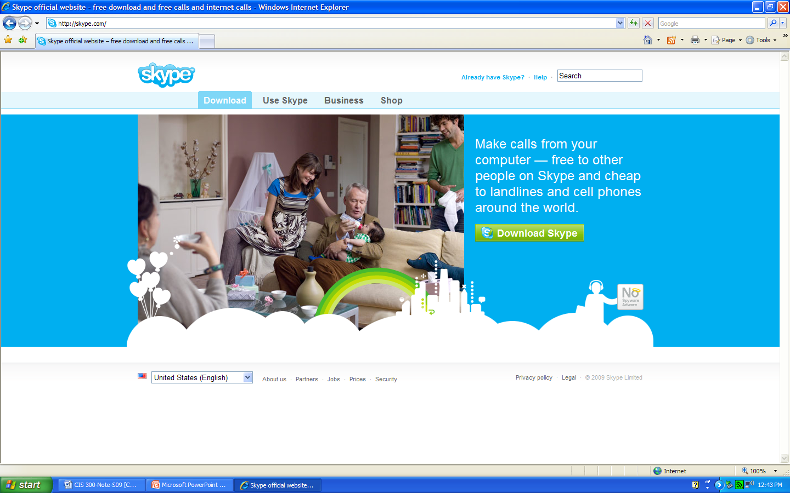
VoIP
(www.skype.com)

Slide 22
Podcasting
Podcast
  Publishing sound and video on the Web for download
  Usually on a subscription basis (RSS Feed)
Uses include:
  “Time-shifted” broadcast of radio station programs for later listening
  Audio tours in museums
  Lectures in distance learning courses
  www.garageband.com
    Allows aspiring musicians to post music tracks

Slide 23
RSS
Really Simple Syndication (RSS)
  Family of XML file formats that allow automatic downloads of content on a subscription basis
  Helps users check for updates
  Communicates short descriptions of content
  Allows transmittal of new information
  Useful on news Web sites
  Also called Rich Site Summary
Aggregators or Feed Readers
  Software that automatically checks for new content and downloads files from a designated site
  www.rssreader.com
  www.bottomfeeder.com

Slide 24
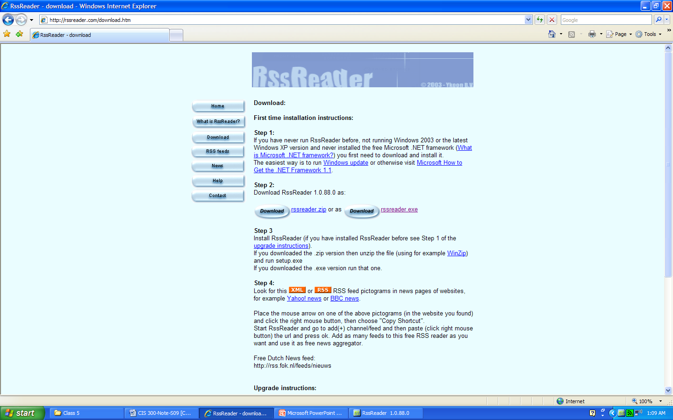
Download my RSS Reader at www.rssreader

Slide 25
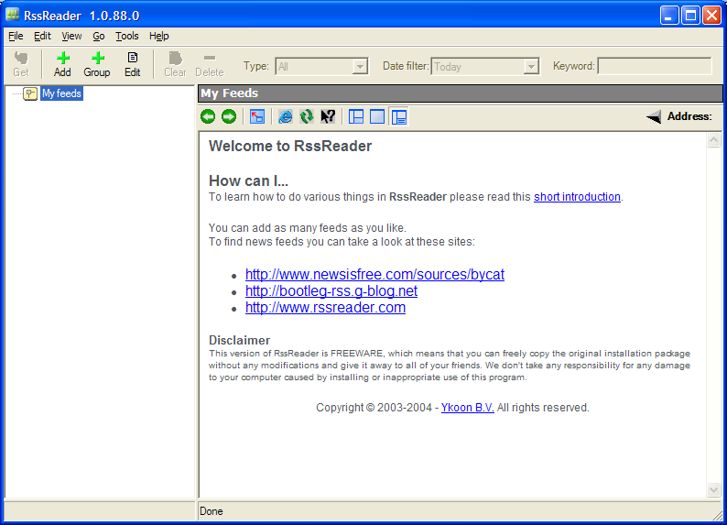
Open My RSS Reader

Slide 26
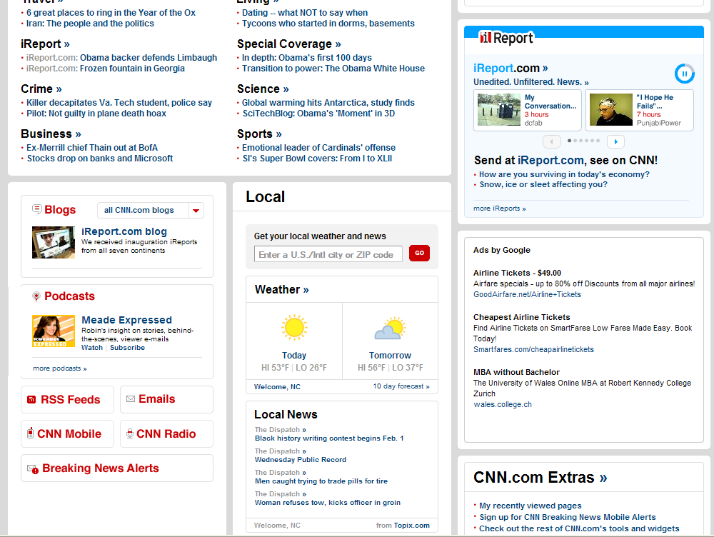
Go to www.CNN.com

Slide 27
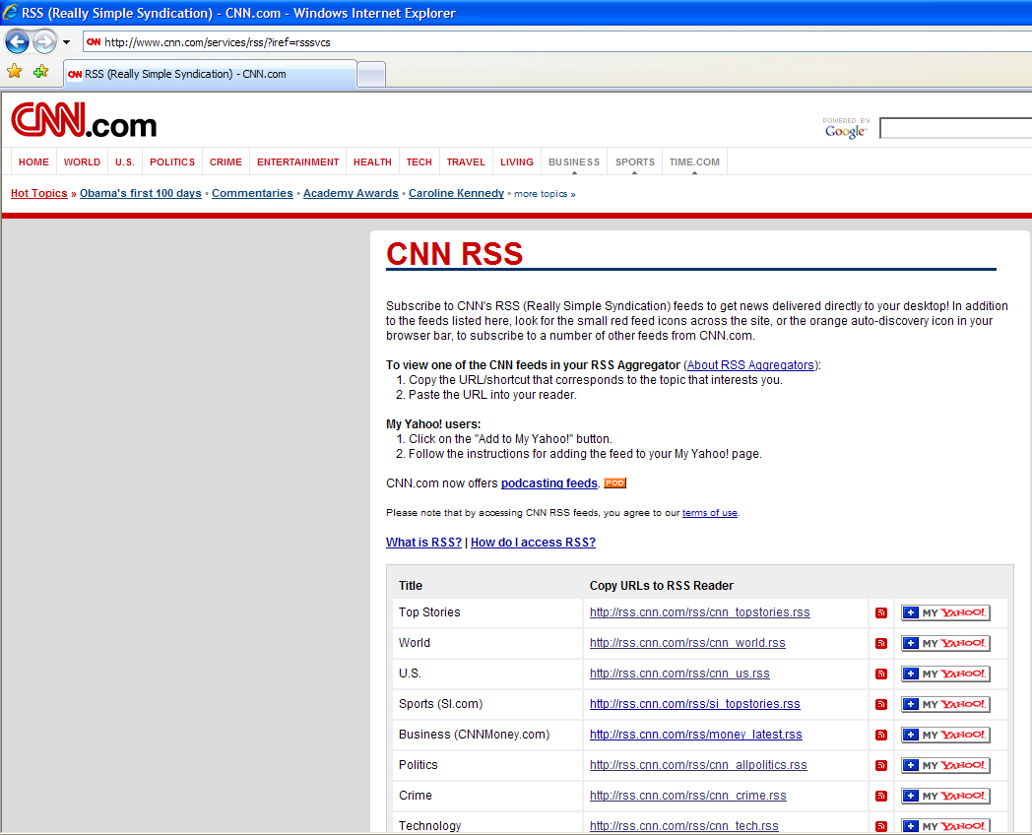
Copy the URL to the RSS Reader

Slide 28
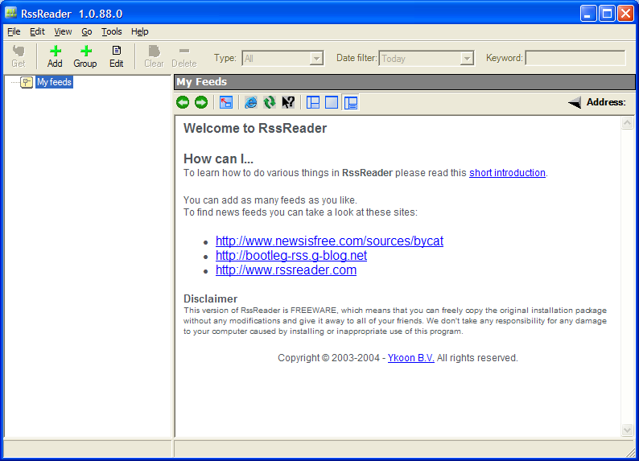
Go Back to My RSS Reader

Slide 29
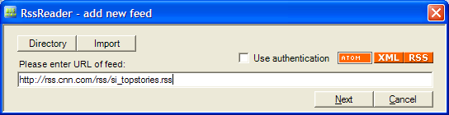
Paste the URL

Slide 30
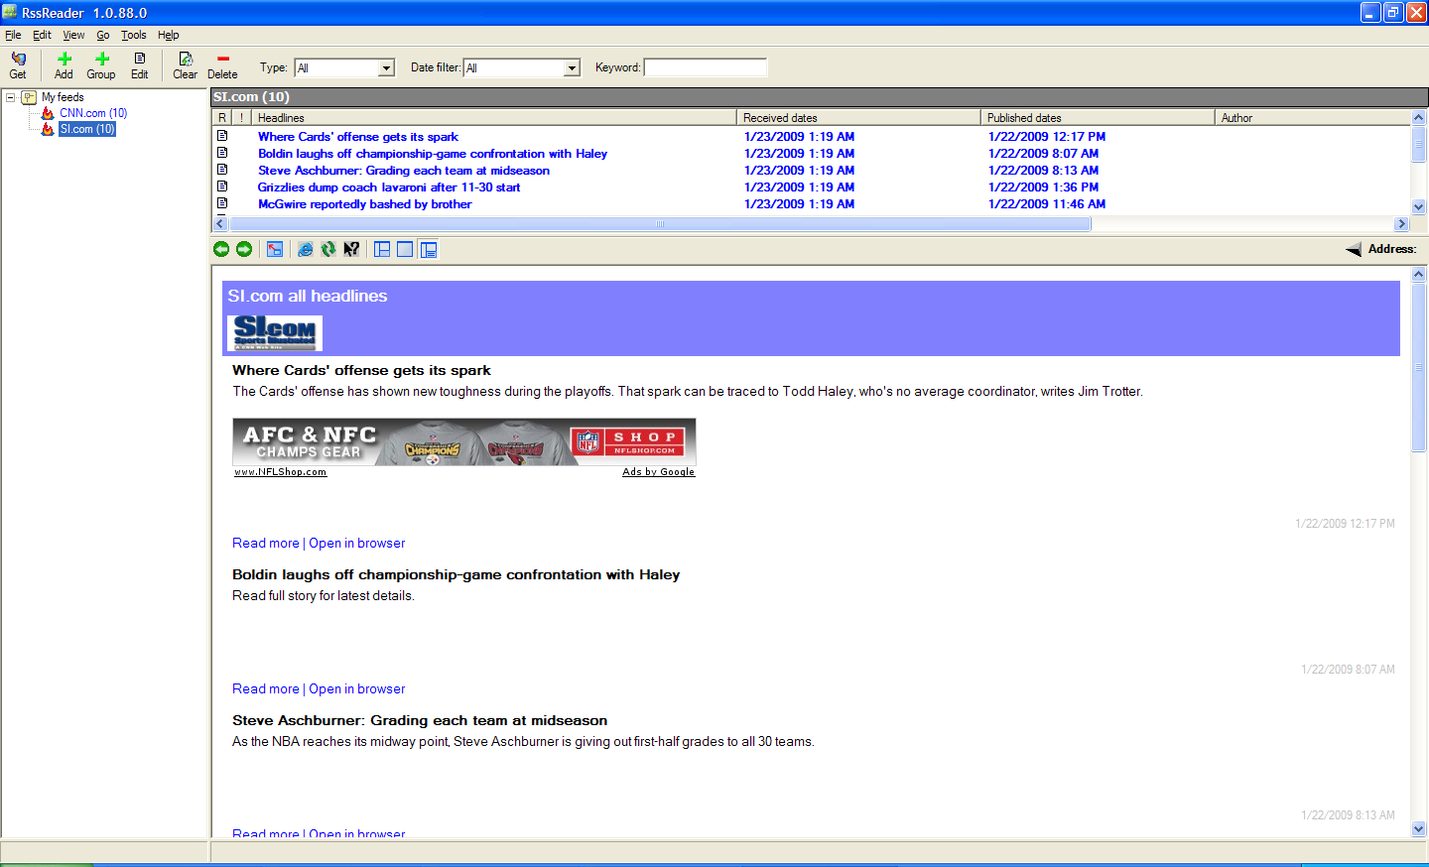
And Now You Are Subscribed!

Slide 31
What Information Systems Support Meeting Communications?
Conference calls
  Several people connected in one phone call
Video conferencing
  Conference call with video camera
Net meeting
  Proprietary product that produces video conference
WebEx
  Moderated conference call
Web cast
  Meeting broadcast over the Internet

Slide 32
How Do Teams Use IS to Share Resources?
IS used by teams:
  Configuration management systems
  Workflow control systems

Slide 33
What Is Configuration Management?
Management process that controls and tracks changes to a shared work product
  Think about your team homework assignments
Process
  Team must follow configuration procedures for checking documents in and out and for making changes
  Failure can cause loss of control over product
Version management software
  Used by teams
  Control configuration of documents, designs, electronic versions

Slide 34
What Is Workflow Control?
Systems that monitor execution of team’s processes
Ensures appropriate actions are taken in proper sequence
Prevents missing any steps
All intermediate work is produced

Slide 35
Review
What is collaboration?
How do teams use IS to support
  Written communication?
  Verbal communication?
  Meeting communications?
How do teams use IS to share resources?
  Configuration management
  Workflow management

Slide 36
Test 1 Review
Remember REACH Review Sessions
(see BB > Announcements)

Slide 37
Stop Tegrity!

